Slide 1
Understanding
Government-Mandated Project Labor Agreements
Updated June 24, 2021

Slide 2
Overview of Government-Mandated PLAs

Slide 3
GOVERNMENT-MANDATED PLAS REDUCE COMPETITION
A project labor agreement mandate artificially creates monopolies for unionized contractors and union trade workers on taxpayer-funded construction jobsites.
PLAs discourage competition from quality local contractors and local construction professionals not affiliated with unions.
PLAs often discourage most local merit shop contractors from bidding because PLAs can harm a company’s existing workforce that chooses not to belong to a union.
Notes:
According to the results of a December 2018 ABC membership survey published in January 2019:
98 percent of survey respondents said they were less likely to bid on a taxpayer-funded construction contract if the bid specifications required the winning firm to sign a PLA with labor unions

Slide 4
GOVERNMENT-MANDATED PLAS REDUCE COMPETITION
PLAs require contractors to obtain most or all employees from union hiring halls and union apprenticeship programs, many of which use out-of-area union labor.
PLAs force contractors and employees to follow inefficient and counterproductive union job classifications and work rules contained in local union collective bargaining agreements. This adds additional costs because it eliminates multiskilling and is a source of bureaucratic frustration for employees and contractors.
PLAs force contractors to pay into union benefit plans, including multi-employer union pension plans that can put merit shop contractors at risk of huge pension withdrawal liabilities, especially if the plans are underfunded.
Notes:
http://www.abc.org/News-Media/Newsline/entryid/16019/survey-abc-members-strongly-oppose-government-mandated-plas

Slide 5
PLAS HARM NONUNION EMPLOYEES
PLAs force existing local employees to accept union representation as a condition of employment, without a union representation election.
Nonunion employees are required to pay non-refundable union dues and/or join a union in order to work on a PLA project and receive earned benefits.
PLAs require non-signatory contractors to pay their employees’ health and welfare fringe benefits to union benefit funds, even if they have existing high-quality plans; increased benefits costs estimated at 25%.
Nonunion employees lose these fringe benefits and extra fringe benefits compensation unless they join a union; 20% reduced pay/lost benefits due to PLA wage theft.
Notes:
Employees who don’t belong to a union don’t benefit from PLAs. An October 2009 report by Dr. John R. McGowan, "The Discriminatory Impact of Union Fringe Benefit Requirements on Nonunion Workers Under Government-Mandated Project Labor Agreements," finds that employees of nonunion contractors that are forced to perform under government-mandated PLAs suffer a reduction in their take-home pay that is conservatively estimated at 20 percent. PLAs force employers to pay employee benefits into union-managed funds, but employees will never see the benefits of the employer contributions unless they join a union and become vested in these plans. Employers that offer their own benefits, including health and pension plans, often continue to pay for existing programs as well as into union programs under a PLA. The McGowan report found that nonunion contractors are forced to pay in excess of 25 percent in benefit costs above and beyond existing prevailing wage laws as a result of “double payment” of benefit costs as a result of a PLA.
According to the results of a December 2018 ABC membership survey published in January 2019:
95 percent of survey respondents said make fringe benefit contributions into union pension and benefit programs on behalf of employees working on the PLA project instead of existing company benefit plans, would harm employees
97 percent of survey respondents said a PLA would result in worse local hiring outcomes for a project
More on minority, women, veteran and disadvantaged workers

Slide 6
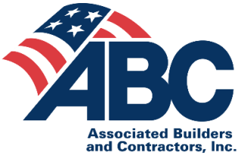
STATE-BY-STATE CONSTRUCTION INDUSTRY
NONUNION WORKFORCE DENSITY (2020)
76.9
85.0
89.5
94.3
90.7
76.4
94.2
96.1
76.9
79.7
75.6
79.9
83.5
95.6
97.3
78.9
81.7
93.7
78.3
77.6
78.3
86.6
69.3
84.7
78.5
96.0
82.1
95.7
89.9
95.1
73.4
97.5
87.8
92.1
90.7
95.4
95.2
92.5
76.4
95.9
97.1
92.5
96.6
95.5
89.8
91.9
92.5
Construction Industry Workforce 87.3% Nonunion
95.2
96.6
Above National Average
83.8
Below National Average
Notes:
Source: Unionstats.com, Table III
BLS rate for 2020 is 87.3% nonunion
Learn More: https://thetruthaboutplas.com/2021/01/30/bls-87-3-of-u-s-construction-industry-does-not-belong-to-a-union/
Updated state-specific union membership information for various industries, including the construction industry, is available at www.unionstats.com (see table III), which is mined from raw data published by U.S. DOL’s Bureau of Labor Statistics.

Slide 7
PLA MANDATES EXACERBATE THE CONSTRUCTION INDUSTRY’S SKILLED WORKFORCE SHORTAGE
2020 union membership for the U.S. construction industry workforce
U.S. Construction Industry Unemployment Rate: 6.7%* (May)
n Union n Nonunion
U.S. Construction Industry Workforce: 7.424 million* (May)
U.S. Construction Industry needed to hire an additional 430,000 people in 2021 to meet construction industry demands*
ABC’s Construction Confidence Indicator: Majority of contractors expect to increase staffing levels and increase sales, but expect a decline in profit over the next six months
ABC’s Construction Backlog Indicator: 8.0 months (May)
For example, Virginia in 2020: 2.5% Union
U.S. Construction Spending: A record $1.43 trillion in 2020
*Prior to the COVID 19 pandemic, the industry had 7.6M employees and a 5.5% unemployment rate (February 2020).
Notes:
See: https://thetruthaboutplas.com/2021/01/30/bls-87-3-of-u-s-construction-industry-does-not-belong-to-a-union/
Updated state-specific union membership information for various industries, including the construction industry, is available at www.unionstats.com (see table III), which is mined from raw data published by U.S. DOL’s Bureau of Labor Statistics.
Latest Unemployment rate for construction industry: https://www.bls.gov/iag/tgs/iag23.htm
Economic data by ABC: http://www.abc.org/News-Media/News-Releases/archives/all
Construction industry skilled labor shortage: https://abc.org/News-Media/News-Releases/entryid/18636/abc-the-construction-industry-needs-to-hire-an-additional-430-000-craft-professionals-in-2021
Historical Construction Value Put in Place:
https://www.census.gov/construction/c30/historical_data.html
2020 Construction Value Put in Place:
Total: $1.43T
Total Private Construction: $1.079T
Private Residential: $607.89B
Private NonResidential: $471.45B
Public Construction: $351B
Residential: $8.58B
Nonresidential: $342.4B
Within Public:
Federal: $26.691B
State and Local: $324.3B

Slide 8
PLAS HARM WORKFORCE DEVELOPMENT
Question: If a PLA required your firm to hire most or all of your company’s apprentices from only union apprenticeship programs, would that harm or help your company’s investment in workforce development programs to address the industry’s skilled workforce shortage?
Number of respondents
Percent of respondents
“
If a PLA forced us to hire apprentices through union apprenticeship programs, it would undermine our firm’s investment in workforce development. Our employees undergo regular classroom and on-the-job training to ensure safety and quality performance and our apprentices participate in government recognized apprenticeship programs not affiliated with unions. We would not be able to use them on PLAs and would be replacing our people with strangers from union halls and apprenticeship programs who may not meet our high standards of integrity, quality, performance and excellence.”
Notes:
Source: Dec. 2018 survey of ABC membership
http://www.abc.org/News-Media/Newsline/entryid/16019/survey-abc-members-strongly-oppose-government-mandated-plas
Blog post explains how GMPLAs exacerbate the construction industry’s skilled labor shortage here:
https://thetruthaboutplas.com/2021/03/30/government-mandated-project-labor-agreements-exacerbate-construction-industrys-skilled-labor-shortage/
According to the results of a December 2018 ABC membership survey published in January 2019:
97 percent of survey respondents said a PLA would result in worse local hiring outcomes for a project
Almost 90 percent of respondents agreed that a PLA would decrease the hiring of women, veteran and disadvantaged business enterprises and construction workers, which have traditionally been unaffiliated with labor unions.

Slide 9
PLA MANDATES CHOKE OFF A VIABLE WORKFORCE DEVELOPMENT PIPELINE
ABC’s 69 chapters and affiliated training centers in 1,400 locations across the country offer more than 800 apprenticeship, craft, safety and management education programs, including more than 300 government-registered apprenticeship programs in 20 different occupations.
430,000 jobs
Need to be filled in the construction industry in 2021
$1.3 billion
invested by ABC members in workforce development in 2020
517,000
course attendees in 2020
Notes:
According to the results of Associated Builders and Contractors 2021 Workforce Development Survey, ABC contractor members invested $1.3 billion on workforce development initiatives in 2020, providing craft, leadership and safety education to 517,000 course attendees to advance their careers in commercial and industrial construction. Safety education accounted for nearly half of the total workforce investment, averaging $2,369 per employee annually.
https://www.abc.org/News-Media/News-Releases/entryid/17581/abc-members-provided-education-for-1-1-million-course-attendees-in-2019-new-survey-finds
ABC member companies invest to build a construction workforce that is safe, skilled and productive using flexible, competency-based and market-driven education methodologies. This all-of-the-above approach to workforce development has produced a network of ABC chapters and affiliates in 1,400 locations across the country that offer more than 800 apprenticeship, craft, safety and management education programs—including more than 300 U.S. Department of Labor or state equivalent government-registered apprenticeship programs across 20 different occupations—to build the people who build America.
Some states have data on registered apprenticeship program participation they submit to the U.S. DOL. Approximately 30K to 40K construction industry apprentices graduate from federal and state government-registered apprenticeship programs per year: https://thetruthaboutplas.com/2021/03/30/government-mandated-project-labor-agreements-exacerbate-construction-industrys-skilled-labor-shortage/
According to the results of Associated Builders and Contractors 2020 Workforce Development Survey, ABC contractor members invested $1.5 billion on workforce development initiatives in 2019, providing craft, leadership and safety education to 1.1 million course attendees to advance their careers in commercial and industrial construction. Safety education accounted for nearly half of the total workforce investment, averaging $1,147 per employee annually.

Slide 10
PLAS HARM MINORITY, WOMEN, VETERAN, SMALL AND DISADVANTAGED BUSINESSES AND WORKERS
Question: Would a government-mandated PLA result in increased or decreased hiring of minority, women, veteran and disadvantaged business enterprises?
Percent of respondents
“
There are more nonunion minority, women, veteran, small and disadvantaged business and construction workers than their union counterparts in the U.S and in every market. The concept that a PLA somehow helps these firms and workers win more work is an impossibility and is not supported by data or facts. In my community, disadvantaged businesses actively oppose government-mandated PLAs because they have the practical impact of excluding them from opportunity and they undermine workforce diversity, equity and inclusion programs in public works contracting.”
82% of all construction firms have less than 10 employees.
Construction Companies Who Employ < 100 Construction Professionals:
Account for 99% of Construction Firms in U.S.
Build 63% of Construction in U.S., by value
Account for 68% of all Construction Industry Employment
Notes:
According to the results of a December 2018 ABC membership survey published in January 2019:
Almost 90 percent of respondents said that a PLA would decrease the hiring of women, veteran and disadvantaged business enterprises and construction workers, which have traditionally been unaffiliated with labor unions.
94 percent said they would expect less competition from subcontractors for construction contracts subject to a government-mandated PLA.
97 percent of survey respondents said a PLA would result in worse local hiring outcomes for a project
Source: Dec. 2018 survey of ABC membership
http://www.abc.org/News-Media/Newsline/entryid/16019/survey-abc-members-strongly-oppose-government-mandated-plas
81% of all construction firms have less than 10 employees
Construction Companies who employ <100 Construction Professionals account for 99% of Construction Firms in USA
Construction Companies who employ <100 Construction Professionals build 63% of construction in US by value
Construction Companies who employ <100 Construction Professionals account for 68% of Construction Employment

Slide 11
GOVERNMENT-MANDATED PLAS INCREASE COSTS
Government-mandated PLAs increase school construction costs between 12% and 20%, on average.
Studies conducted in CT, NJ, OH, CA, MA, and NY on hundreds of school projects built with and without PLA mandates.
Obama administration’s U.S. DOL Job Corps Center in New Hampshire had three times as many bidders and saved 16% without PLA mandate.
Studies available at TheTruthAboutPLAs.com.
Notes:
According to the results of a December 2018 ABC membership survey published in January 2019:
97 percent of survey respondents said a construction contract that required a PLA would be more expensive compared to a contract procured via free and open competition.
Research on cost and other impact of GMPLAs available at: https://thetruthaboutplas.com/2012/12/28/plastudies/
Recent example of federal U.S. DOL project in Manchester, N.H., that had increased competition, reduced costs and a local workforce after PLA was removed following a round of bidding with a PLA:
https://thetruthaboutplas.com/2015/10/26/u-s-department-of-labor-job-corps-center-opening-demonstrates-value-of-open-competition/
Numerous projects bid with and without PLAs mandates in real world examples.

Slide 12
HOW DO GOVERNMENT-MANDATED PLAS INCREASE COSTS BY 12% TO 20%?
Labor costs
Inefficient union work rules and lost productivity.
Double health and pension costs to any nonunion contractors who pursue PLA projects.
Compliance costs
Attorney costs and delays complying with PLA.
Lost nonunion worker wages and benefits.
Competitive costs
Economic theory in competitive bidding.
Correlation between less competition and higher labor and construction costs.
Notes:
A variety of studies on the cost of PLAs can be found at http://thetruthaboutplas.com/tag/anti-pla-mandate-study/
Beacon Hill Institute (BHI) at Suffolk University in Boston, Mass., conducted multiple studies analyzing the effect PLAs have on school construction projects in Connecticut, Massachusetts, New Jersey, New York, and Ohio. The studies determined PLAs add 12% to 20% to construction costs and also inflated construction bid costs. A similar July 2011, study released by the National University System Institute for Policy Research (NUSIPR), found California school construction projects built using government-mandated PLAs experienced increased costs of 13% to 15%, or $28.90 to $32.49 per square foot, compared to projects that did not use a PLA. A 2010 study by the New Jersey Department of Labor and Workforce Development found PLAs on school construction projects in the state were 30.5 percent higher than for all non-PLA projects. The same report found PLA projects tended to have a longer duration than non-PLA projects. For FY 2008, the average duration of PLA projects was 100 weeks compared with 78 weeks for non-PLA projects.
Employees who don’t belong to a union don’t benefit from PLAs. An October 2009 report by Dr. John R. McGowan, "The Discriminatory Impact of Union Fringe Benefit Requirements on Nonunion Workers Under Government-Mandated Project Labor Agreements," finds that employees of nonunion contractors that are forced to perform under government-mandated PLAs suffer a reduction in their take-home pay that is conservatively estimated at 20 percent. PLAs force employers to pay employee benefits into union-managed funds, but employees will never see the benefits of the employer contributions unless they join a union and become vested in these plans. Employers that offer their own benefits, including health and pension plans, often continue to pay for existing programs as well as into union programs under a PLA. The McGowan report found that nonunion contractors are forced to pay in excess of 25 percent in benefit costs above and beyond existing prevailing wage laws as a result of “double payment” of benefit costs as a result of a PLA.
Recent example of federal U.S. DOL project in Manchester, N.H., that had increased competition, reduced costs and a local workforce after PLA was removed following a round of bidding with a PLA:
https://thetruthaboutplas.com/2015/10/26/u-s-department-of-labor-job-corps-center-opening-demonstrates-value-of-open-competition/
Responses to critiques of research showing added costs of PLA mandates:
http://thetruthaboutplas.com/2014/05/01/the-truth-about-project-labor-agreement-research/

Slide 13
FAIR AND OPEN COMPETITION: A WIN-WIN FOR TAXPAYERS AND THE ECONOMY
Inclusive policy benefitting all of America’s construction industry.
Results in more long-lasting high-quality construction projects built at the best possible price.
Ensures taxpayer dollars are spent effectively delivering more projects and jobs for the investment.
Helps businesses, including diverse, local, small and MWDBE firms and workers compete and grow.
Incentivizes and rewards productivity, innovation and value creation.
Stimulates job growth, career enhancement and opportunity for all.
Notes:
According to the results of a December 2018 ABC membership survey published in January 2019:
58% of survey respondents said a PLA would decrease the quality of construction on that PLA project and 41% said it would make no difference
81% of survey respondents said a PLA would decrease the likelihood of the PLA project being built on time and on budget and 18% said it would make no difference
50% of survey respondents said a PLA would that make a company’s performance on that PLA project more less safe and 49% said it would make no difference
Safety:
Data shows that states with laws prohibiting government-mandated PLAs averaged a lower level of total recordable incidents, with an average of 2.4, while states that allow and encourage government-mandated PLAs averaged 3.5 total recordable construction incidents. The U.S. Bureau of Labor Statistics is the federal agency tasked with calculating and reporting workplace injuries, which is primarily performed through the BLS Survey of Occupational Injuries and Illnesses and the BLS Census of Fatal Occupational Injuries. The SOII includes data on total recordable incident rates (TRIR) and days away, restricted or transferred rate (DART) in the construction industry. The number is represented as the number of injuries and illnesses per 100 full-time equivalent workers.
Strikes:
Strikes and work stoppages on construction projects are rare and are caused ONLY by unions, so PLAs are an extortionary solution in search of a problem:
The U.S. Department of Labor Bureau of Labor Statistics’ Work Stoppages Program, which tracks major work stoppages involving 1,000 or more workers, found there have been just seven major work stoppages in the construction industry in the last 10 years. In addition, according to the most recent data available from the Federal Mediation and Conciliation Service, there were just 45 construction industry work stoppages from 2015-2019 and 101 work stoppages from 2010 to 2014. Source: https://thetruthaboutplas.com/2021/03/29/do-project-labor-agreements-stop-strikes-on-construction-jobsites/

Slide 14
VOTERS PREFER FAIR AND OPEN COMPETITION
Question: If you had to choose, which policy would provide a better value for taxpayers?
Notes:
89 percent of poll respondents think requiring a fair and open competitive bidding process for all contractors, regardless of whether or not their workers are in a union, can provide a better value for taxpayers.
11 percent think requiring contractors to sign a union contract to work on a construction project provides better value for taxpayers.
According to the results of a December 2018 ABC membership survey published in January 2019:
83% of respondents would you be more likely to support a lawmaker who supports policies ensuring fair and open competition on taxpayer-funded construction projects by restricting government-mandated PLAs

Slide 15
24 STATES ENSURE FAIR AND OPEN COMPETITION
n No policy prohibiting or encouraging use of PLAs n Enacted pro-PLA bill or EO encouraging government-mandated PLAs
n Enacted bill or EO prohibiting government-mandated PLAs (year enacted)
*Policy prohibiting government-mandated PLAs rescinded
WA
NH
ME*
ID
(2012)
MT
(1999)
MN*
VT
OR
ND
(2013)
WI
(2017)
NY
MA
SD
(2014)
MI
(2011)
WY
RI
CA
IA
(2017)
PA
CT
NV*
NE
IL
OH
NJ
UT
(1995)
IN
DE
WV
(2015)
CO
MO
(2017)
VA*
MD
KS
(2012)
KY(2019)
NC (2013)
AZ
(2011)
NM
TN
(2011)
AK
OK
(2012)
AR
(2015)
SC
(2013)
24 states ensure fair and open competition
TX
(2019)
AL
(2014)
GA
(2013)
MS (2014)
LA
(2011)
FL
(2017)
Notes:
Virginia’s FOCA law, enacted in 2012, was repealed by Virginia in 2020, effective May 1, 2021, bringing the total number of states down to 24.
On June 2, 2019, Texas Gov. Greg Abbott (R) signed HB 985 into law, making TX the 25th state to enact a FOCA policy.
On May 28, 2019, Nevada Gov. Steve Sisolak (D) signed SB 231, rescinding Nevada’s FOCA statute passed in 2015 and dropping the number of FOCA states to 24.
In 2019, Kentucky was the 25th state to pass FOCA and restrict government-mandated project labor agreements and ensure all Americans can compete to rebuild their communities.
In total, Texas is the 27th state to take action on FOCA since 2011. (FYI, Utah and Montana had statutes in place pre-2011. Minnesota (EO), Maine and Nevada had their FOCA policies repealed.)
State FOCA statutes has led to fair markets across the country.
Resource tracking all state FOCA laws:
https://thetruthaboutplas.com/wp-content/uploads/2020/02/Current-State-FOCA-Laws-GMPLA-Bans-through-Texas-Updated-June-3-2019.xlsx

Slide 16
PREVAILING WAGE LAWS ACROSS THE COUNTRY
n No prevailing wage law (date of repeal) n Prevailing wage law
WA
NH
(1985)
ME
ID
(1985)
MT
MN
VT
ND
OR
NY
WI
(2017)
MI
(2018)
MA
WY
SD
RI
CA
IA
PA
CT
NV
NE
IL
OH
NJ
UT
(1981)
IN (2015)
DE
WV (2016)
CO
MO
VA
MD
KS
(1987)
KY (2017)
NC
AZ
(1984)
NM
TN
AK
OK
(1995)
AR
(2017)
SC
TX
AL
(1980)
GA
22 states have no prevailing wage laws
MS
LA
(1988)
FL
(1979)
Notes:
Good source of data/research on state prevailing wage laws at www.abc.org/DavisBacon under State Tab:
http://abc.org/Portals/1/2021%20Files/State%20Prevailing%20Wage%20Law%20Research%20Database%20Updated%20030321.xlsx?ver=2021-03-03-151925-147
Newsline article on ABC member survey on Davis-Bacon and Prevailing Wage:
http://abc.org/News-Media/Newsline/entryid/18540/survey-says-abc-members-strongly-support-repeal-or-reforms-to-costly-davis-bacon-act-and-prevailing-wage-laws
As of June 1, 2021, 22 states do not have prevailing wage laws.
In 2020, Virginia enacted a law (SB8/HB833) permitting localities to require prevailing wage on local projects and requiring prevailing wage on state projects exceeding $250K. The law took effect May 1, 2021, which is why VA is now a state with a PW law. It was the first state to enact a new PW law (one that had not been previously rescinded) since Minnesota.
Colorado Democrats included a provision in the Colorado Quality Apprenticeship Training Act Of 2019 that requires the payment of prevailing wages to workers in the mechanical, electrical and plumbing industries on projects over $500,000. The legislation mandates that the state prevailing wage follow the wage determinations made the United States Department of Labor. Colorado repealed their prevailing wage law in 1985 and was the only state to implement a new prevailing wage policy in 2019.
On his very first day in office, Illinois Gov. Pritzker (D) delivered multiple executive orders rewarding the building trades for their support in the 2018 Midterms, including reversing a Rauner-era EO discouraging PLAs on state funded projects and a separate EO revising the state’s prevailing wage calculation process. In addition, the legislature passed numerous pieces of legislation that will impact ABC, including prohibiting local Right-to-Work ordinances, requiring union labor on certain types of projects like data centers and coal ash cleanup, and encouraging local governments to adopt responsible contractor ordinances. ABC Illinois was able to defeat SB 1407, which would have expanded prevailing wage into certain private projects, an effort that was supported financially by FEA. However, legislative Democrats are expected to make another run at prevailing wage expansion in the future.
Nevada’s newly elected Gov. Steve Sisolak (D) promised the construction unions he would roll back the 2015 FOCA law and reforms made to prevailing wage, which both ended up coming to fruition in the 2019 legislative session.
New Hampshire House and Senate Democrats introduced a bill restoring prevailing wage requirements on state funded projects. Gov. Sununu vetoed the bill in July and there were not enough votes for a veto override, thanks to ABC advocacy efforts.
New York’s powerful building trades unions were pushing for a law that would have expanded the definition of “public works” in New York to include projects receiving more than 30 percent of their funding from the government – making those projects eligible for prevailing wages. The ABC Empire Chapter focused nearly all legislative efforts towards defeating this bill and was successful doing so. The bill was alive until the final days of session but ultimately a push to exempt projects in New York City doomed the bills fate.

Slide 17
Federal Policies on Fair and Open Competition
Notes:
Key blog posts:
2021 Update: ABC’s Fight Against Government-Mandated Project Labor Agreements:
https://thetruthaboutplas.com/2021/02/10/february-2021-update-abcs-fight-against-government-mandated-project-labor-agreements/
How Will The 2020 Election Shape Federal Policy on Project Labor Agreements?
https://thetruthaboutplas.com/2020/10/12/how-will-the-2020-election-shape-federal-policy-on-project-labor-agreements/

Slide 18
EXECUTIVE ORDER 13502; OBAMA ADMINISTRATION’S PRO PLA POLICY REMAINS
President Obama’s 2009 EO 13502 repealed President Bush’s 2001 EOs 13202 and 13208 restricting government-mandated project labor agreements on federal and federally assisted projects.
Bush EOs protected $147B worth of direct federal construction contracts and hundreds of billions of dollars in federally assisted project contracts.
Obama EO impacts only federal contracts > $25M.
A PLA encouragement rather than a blanket mandate.
Federal agency procurement officials decide PLA mandate on a case-by-case basis.
State and local governments can require PLAs on federally assisted projects.
FAR council final rule on EO 13502 issued April 12, 2010, effective May 12, 2010.
Notes:
July 14, 2009 the Federal Acquisition Regulation (FAR) Council issued a final rule (FAR CASE 2009-015, Revocation of Executive Order 13202) rescinding the Bush FOCA EOs and issued a proposed rule (FAR Case 2009-005, Use of Project Labor Agreements for Federal Construction Projects) that will implement Executive Order 13502 into federal procurement regulations.
The proposed rule was subject to two 30-day comment periods during which the public could submit comments related to the proposed rule. The first comment period closed Aug. 14, 2009; it was reopened on Aug. 24 and closed again on Sept. 24.
TheTruthAboutPLAs.com readers, associations, taxpayers, contractors and hard hat employees answered our call to action in opposition to the proposed rule and submitted almost 1,000 comments to the FAR Council. ABC National’s comments can be viewed here (www.abc.org/plastudies), and every comment submitted to the FAR Council is available for public review here.
A final rule was issued April 12, 2010, effective May 13, 2010. Why the delay?
With a few exceptions, federal agencies and procurement officials have not attempted government-mandated PLAs, partially of successful GAO bid protests against initial PLA mandate efforts, and partially because PLAs are bad public policy. These special interest giveaways increase the cost of construction, are a form of government corruption and discriminate against nonunion contractors and employees.
The order does not require PLAs on federally assisted projects, but permits recipients of federal assistance procuring construction projects to mandate PLAs (because the Bush order restricting GMPLAs on fed. assisted projects was rescinded).
Legal challenges: http://thetruthaboutplas.com/2013/01/22/legal-challenges-against-federal-government-mandated-project-labor-agreements-during-president-obamas-first-term/
Legal overview: https://thetruthaboutplas.com/2021/02/17/2021-update-courts-rule-in-favor-of-nopla-laws-promoting-fair-and-open-competition/
Federal PLA surveys: http://thetruthaboutplas.com/tag/pla-survey/

Slide 19
PLA MANDATES ON FEDERAL CONTRACTS
Total value of PLA mandate/preference contracts greater than $25M, FY2009-FY2020
Non-GMPLA contracts far outnumber GMPLA contracts by value (98.93%) and number of contracts (99.36%) on $117.36B offed. projects greater than $25M.
There were no fed. GMPLAs during the Trump presidency
n PLA n Non-PLA
$1.25 B
$116.1 B
12
1,877
Source: USASpending.gov (accessed 12/22/20) cross-referenced with known list of federal PLA mandates, 12/22/20.
Notes:
Data Source: FY2020 Prime United States NAICS 23 Contracts Greater Than or Equal to $25M, data from USASpending.gov (accessed 12/22/20 and cross-referenced with ABC Membership Database annual report (accessed 12/22/20).
FY2020 raw data filtered by US NAICS 23 performed in USA and GUAM: https://files.usaspending.gov/generated_downloads/All_PrimeTransactionsAndSubawards_2020-12-21_H16M05S41126189.zip
Summary
According to data extracted from USASpending.gov and compared to the ABC membership database, from FY2009-FY2020 there were 1,889 prime federal NAIC 23-classified construction contracts exceeding $25 million worth a total of $117.36 billion performed in the U.S. and territories.
Data analysis found 976 out of 1,889 large-scale federal prime U.S. construction contracts were awarded to ABC members (51.67% of all contracts), totaling $67.5 billion in total value (57.52% of total value).
1,877 (1,889-12) contracts worth ($117.36B-$1.24B) $116.1 B were built without government-mandated PLAs.
Just 12 of these contracts (less than 1% of 1,889 contracts) worth $1.25 billion (1.07% of total value of $$117.36 B) were built with government-mandated PLAs/PLA preferences.
ABC member prime general contractors are industry leaders and quality contractors. They have won the majority of large-scale federal construction contracts from FY2009-FY2020. This data does not include contracts performed by quality ABC member subcontractors or PLAs voluntarily entered into by general contractors or subcontractors.

Slide 20
ABC MEMBERS WON MAJORITY OF LARGE-SCALE FEDERAL CONTRACTS >$25M, FY2009-FY2020
 | # of Contracts | Percent of # of Contracts | Value (in $ billions) | Percent of Total Value
ABC | 976 | 51.67% | $67.5 | 57.52%
Non-ABC | 913 | 48.33% | $49.8 | 42.48%
Total | 1,889 | 100% | $117.36 | 100%
Source: USASpending.gov cross-referenced with ABC Membership, 12/22/20.
Notes:
Data Source: FY2020 Prime United States NAICS 23 Contracts Greater Than or Equal to $25M, data from USASpending.gov (accessed 12/22/20 and cross-referenced with ABC Membership Database annual report (accessed 12/22/20).
FY2020 raw data filtered by US NAICS 23 performed in USA and GUAM: https://files.usaspending.gov/generated_downloads/All_PrimeTransactionsAndSubawards_2020-12-21_H16M05S41126189.zip
Summary
According to data extracted from USASpending.gov and compared to the ABC membership database, from FY2009-FY2020 there were 1,889 prime federal NAIC 23-classified construction contracts exceeding $25 million worth a total of $117.36 billion performed in the U.S. and territories.
Data analysis found 976 out of 1,889 large-scale federal prime U.S. construction contracts were awarded to ABC members (51.67% of all contracts), totaling $67.5 billion in total value (57.52% of total value).
1,877 (1,889-12) contracts worth ($117.36B-$1.24B) $116.1 B were built without government-mandated PLAs.
Just 12 of these contracts (less than 1% of 1,889 contracts) worth $1.25 billion (1.07% of total value of $$117.36 B) were built with government-mandated PLAs/PLA preferences.
ABC member prime general contractors are industry leaders and quality contractors. They have won the majority of large-scale federal construction contracts from FY2009-FY2020. This data does not include contracts performed by quality ABC member subcontractors or PLAs voluntarily entered into by general contractors or subcontractors.

Slide 21
ABC MEMBERS WON MAJORITY OF LARGE-SCALE FEDERAL CONTRACTS >$25M, FY17-FY20, BY VALUE
 | # of Contracts | Percent of # of Contracts | Value (in $billions) | Percent of Total Value
ABC | 325 | 46.16% | $25.733 | 50.35%
Non-ABC | 379 | 53.84% | $25.377 | 49.65%
Total | 704 | 100% | $51.11 | 100%
The Trump administration did not mandate PLAs on any projects.
Source: USASpending.gov cross-referenced with ABC Membership, 12/22/20.
Notes:
Data Source: FY2020 Prime United States NAICS 23 Contracts Greater Than or Equal to $25M, data from USASpending.gov (accessed 12/22/20 and cross-referenced with ABC Membership Database annual report (accessed 12/22/20).
FY2020 raw data filtered by US NAICS 23 performed in USA and GUAM: https://files.usaspending.gov/generated_downloads/All_PrimeTransactionsAndSubawards_2020-12-21_H16M05S41126189.zip

Slide 22
LARGE-SCALE FEDERAL CONTRACTS >$25M, FY09-FY20, BY OBAMA AND TRUMP ADMINISTRATIONS
 | # of Contracts |  | Percent of # of Contracts |  | Value (in $Billions) |  | Percent of Total Value
 | Obama | Trump | Obama | Trump | Obama | Trump | Obama | Trump
ABC | 651 | 325 | 54.94% | 46.16% | $41.8 | $25.7 | 63.11% | 50.35%
Non-ABC | 534 | 379 | 45.06% | 53.84% | $24.5 | $25.4 | 36.97% | 49.65%
Total | 1185 | 704 | 100% | 100% | $66.2 | $51.1 | 100% | 100%
The Trump administration did not mandate PLAs on any projects.
Source: USASpending.gov cross-referenced with ABC Membership, 12/22/20.
Notes:
Data Source: FY2020 Prime United States NAICS 23 Contracts Greater Than or Equal to $25M, data from USASpending.gov (accessed 12/22/20 and cross-referenced with ABC Membership Database annual report (accessed 12/22/20).
FY2020 raw data filtered by US NAICS 23 performed in USA and GUAM: https://files.usaspending.gov/generated_downloads/All_PrimeTransactionsAndSubawards_2020-12-21_H16M05S41126189.zip

Slide 23
FEDERALLY-ASSISTED PLA MANDATE CONTRACTS
513 US DOT Federal Highway Administration-approved PLA mandate state construction contracts
May 2010 – Dec. 22, 2020, estimated cost of contracts, in millions of USD
AK
ME
Estimated value from 437 state projects: $12.01 B
Estimated value from 76 Chicago projects: $871.9 M
Total: $12.88 B
VT
NH
WA
ID
MT
ND
MN
$55.3
IL
$5125
WI
MI
NY
$2882
RI
MA
OR
NV
$200
WY
SD
IA
IN
OH
PA
$25
NJ
CT
$728
IL, NY and CA spent the most money on federally assisted projects subject to government-mandated project labor agreements.
CA
$1616
UT
CO
NE
MO
KY
WV
VA
MD
DE
AZ
NM
KS
AR
TN
NC
SC
DC
$608
OK
LA
MS
AL
GA
HI
TX
FL
*Cost amounts based on U.S. DOT FHWA data May 2010 through Dec. 22, 2022, received Jan. 8, 2021; project count includes total contracts approved, project estimates from FHWA data.
Notes:
It is unclear how many federally assisted projects procured by state and local governments are subject to GMPLAs. We only have data from one federal agency.
The value of FHWA-Approved PLAs from May 2010 through end of 2020, is a snapshot of just one federal agency. We don’t know how many federally assisted projects have PLAs mandated on them.
Raw data from FHWA, with additional analysis by ABC within tabs available:
https://thetruthaboutplas.com/wp-content/uploads/2021/01/FHWA-PLA_Summary_Tables_through-122220-Received-010821.xlsx
There is no resource across federal agencies tracking federally assisted state and local construction projects subject to PLA mandates. Most data is uncovered as a result of FOIA requests or unique agency requirements to approve/track/monitor local/state PLA mandates on projects receiving federal money.
President Biden’s U.S. DOT has just encouraged GMPLAs in grant application process for INFRA grants – the first PLA policy expansion by the Biden administration:
https://thetruthaboutplas.com/2021/02/24/u-s-dot-promotes-government-mandated-project-labor-agreements-in-infrastructure-grant-program/

Slide 24
CONSTRUCTION CAPITAL OUTLAY PROTECTED FROM GMPLAS VIA STATE FOCA LAWS (BILLIONS USD, THROUGH 2019)
n Policy prohibiting government-mandated PLAs n Policy encouraging use of PLAs
*Policy prohibiting government-mandated PLAs rescinded
WA
NH
ME*
($2.65)
ID
($7.54)
MT
($13.58)
MN*
VT
OR
ND
($12.96)
WI
($14.79)
NY
MA
SD
($6.64)
MI
($40.83)
WY
RI
CA
IA
($28.99)
PA
CT
NV*
($12.15)
NE
IL
OH
NJ
UT
($38.98)
IN
DE
WV
($6.10)
CO
MO
($25.94)
VA
($49.96)
MD
KS
($19.02)
KY($3.35)
NC ($49.16)
Total capital outlay protected from state government-mandated PLAs, 2007-2019:
$633.22 billion
Total capital outlay protected in 2019: $116.94 billion
AZ
($37.87)
NM
TN
($31.62)
AK
OK
($25.99)
AR
($22.69)
SC
($26.50)
TX
($12.18)
AL
($7.76)
GA
($46.78)
MS ($7.76)
LA
($35.77)
FL
($35.21)
Notes:
ABC’s state FOCA efforts have protected $633.22 billion worth of state/local public works construction projects from GMPLAs 2007-2019, which likely includes state and local construction projects receiving federal dollars/assistance.
Total capital outlay protected in 2019: $116.94 billion.
Data is collected and distributed by the U.S. Census Bureau (https://www.census.gov/construction/c30/pdf/slstate.pdf) through a survey process of state and local governments.
So these Red state laws provide some protection on federally assisted project where state or local statutes are applicable.
Resource tracking all state FOCA laws:
https://thetruthaboutplas.com/wp-content/uploads/2020/02/Current-State-FOCA-Laws-GMPLA-Bans-through-Texas-Updated-June-3-2019.xlsx

Slide 25
AMERICAN RECOVERY PLAN ACT OF 2021
U.S. Treasury Fact Sheet:
ABC ACTION ALERT: May 17 U.S. Treasury Interim Final Rule encourages state and local governments to mandate PLAs on certain eligible infrastructure projects receiving $350B in federal assistance via March 13 ARPA law.
CONTACT TREASURY by July 16.
U.S. Treasury Interim Final Rule:
Notes:
Contact the U.S. Treasury and let them know PLAs should not be encouraged on federally assisted construction projects via ABC Action Alert: https://www.votervoice.net/ABC/campaigns/85116/respond
Educate state and local stakeholders accessing this $350B in federal funding that PLAs are not mandated
Educate state and local stakeholders accessing this $350B in federal funding that PLAs should not be mandated or encouraged in FOCA states (see letter to states and localities)
ABC National will be submitting detailed comments to the Treasury before the July 15 deadline and we are exploring legal options
Treasury IFR from May 17, 2021: https://www.federalregister.gov/documents/2021/05/17/2021-10283/coronavirus-state-and-local-fiscal-recovery-funds#p-280
Treasury Fact Sheet from May 10, 2021: https://home.treasury.gov/system/files/136/SLFRP-Fact-Sheet-FINAL1-508A.pdf
ABC May 24 letter to Treasury: https://abc.org/Portals/1/2021%20Files/ABC%20Letter%20to%20Treasury%20Opposing%20PLA%20Language%20in%20ARPA%20IFR.pdf?ver=2021-05-24-103830-317&timestamp=1621867123750
ABC Newsline article on the issue: https://www.abc.org/News-Media/Newsline/entryid/18771/u-s-treasury-promotes-pla-schemes-on-federally-assisted-public-works-projects

Slide 26
PRESIDENT BIDEN ON PRO-PLA EO 13502
Options:
Take action at an undetermined date, leaving Obama’s order in place in interim
Enhance Obama order by decreasing $25M threshold and/or pushing federal agency officials to expand policy mandating/encouraging more PLAs on federal and federally assisted projects (i.e. Treasury American Recovery Plan guidance, DOT FY21 INFRA grants)
???
Let Congress do dirty work via pro-PLA language in infra, spending bills, or codifying pro-PLA EO into law
ABC will continue its fight against government-mandated PLAs:
Keep this issue radioactive
Public relations campaigns
Grassroots advocacy
Federal agency PLA survey responses
Legal challenges and GAO bid protests against individual federal PLA projects
Notes:
What to watch with Biden administration and GMPLAs:
Treasury’s guidance to state and local governments on $350B in American Recovery Plan spending, which includes infrastructure and pro-PLA language and reporting by state and local recipients: https://thetruthaboutplas.com/2021/05/12/biden-and-treasury-promote-project-labor-agreement-schemes-on-taxpayer-funded-construction-projects-in-american-rescue-plan/
https://www.abc.org/News-Media/Newsline/entryid/18777/abc-responds-to-treasury-pla-guidance
https://www.abc.org/News-Media/Newsline/entryid/18771/u-s-treasury-promotes-pla-schemes-on-federally-assisted-public-works-projects
U.S. Department of Transportation Build America Bureau’s Feb. 17, 2021, announcement that the FY 2021 Infrastructure for Rebuilding America discretionary grant program is encouraging grant applicants to mandated PLAs. The U.S. DOT’s FY 2021 INFRA grant program provides $889 million to fund state and locally procured transportation projects of national and regional significance https://www.transportation.gov/buildamerica/financing/infra-grants/infrastructure-rebuilding-America. See Notice of Funding Opportunity for the Department of Transportation’s Infrastructure For Rebuilding America (INFRA) Program for Fiscal Year 2021, https://www.transportation.gov/buildamerica/sites/buildamerica.dot.gov/files/2021-02/FY%202021%20INFRA%20NOFO.pdf
GSA’s PLA Preference PIB: http://www.abc.org/LinkClick.aspx?link=http%3a%2f%2fthetruthaboutplas.com%2fwp-content%2fuploads%2f2015%2f04%2fGSA-PBS-Procurement-Instructional-Bulletin-on-Project-Labor-Agreement-11-05-080211.pdf&tabid=453&portalid=1&mid=5923&language=en-US
Federal Agency PLA survey process: https://thetruthaboutplas.com/tag/pla-survey/
Learn more at abc.org/pla under Federal tab and Regulations tab

Slide 27
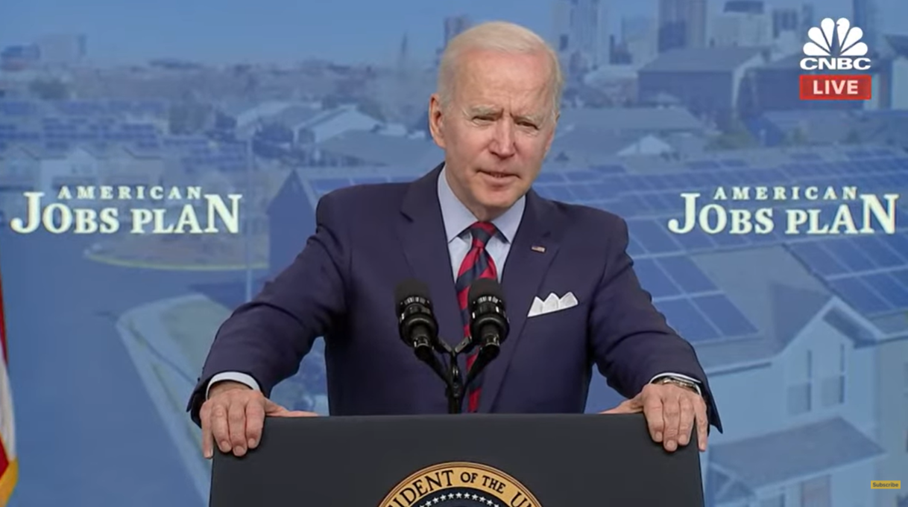
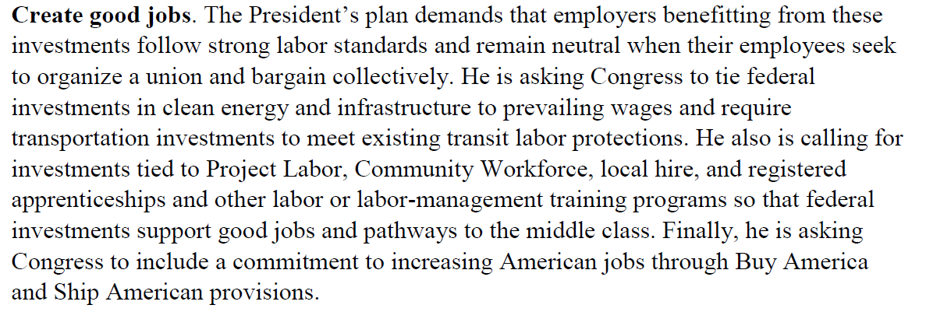
AMERICAN JOBS PLAN LABOR PROVISIONS
PRO Act + Government-Mandated Project Labor Agreements + more = “Good paying union jobs”

Slide 28
FEDERAL GMPLA POLICIES TO WATCH
Oppose:
Pro-PLA mandate/preference language in spending and infrastructure bills
See page 1139 of H.R. 4447, The Clean Economy Jobs and Innovation Act from the 116th Congress as a problematic example
Language codifying current pro-PLA EO into law
U.S. DOT FY 2021 INFRA grant program’s pro-PLA language
Treasury IFR on $350B to states and localities for infrastructure
Expansion of Obama admin EO
Support:
The Fair and Open Competition Act (H.R. 1284/S. 403), introduced by Sen. Todd Young (R-Ind.) and Rep. Ted Budd (R-N.C.), restricting government-mandated PLAs on federal and federally assisted construction projects
Similar state FOCA measures
Taxpayer-funded infrastructure investment that creates opportunities for all qualified businesses, including 87% of U.S. construction workforce
Notes:
Support:
The Fair and Open Competition Act (H.R. 1284 / S. 403), introduced Feb. 24, 2021, by Sen. Todd Young (R-Ind.) and Rep. Ted Budd (R-N.C.), restricting government-mandated PLAs on federal and federally assisted construction projects and creating opportunity for the entire construction industry. Urge lawmakers to cosponsor.
FOCA measures at state and local government, including 25 states that have already passed FOCA. Helps send a message to federal agencies and Congress that PLA mandates are not welcome on construction projects receiving mixed financing
FOCA policies will create a level playing field in the procurement of government construction contracts, increase competition, help small businesses grow, curb construction costs and spread the job-creating benefits of federal and federally funded contracts throughout the construction industry.
Oppose:
In the 116th Congress, House Democrats pushed for PLA mandates on infrastructure projects (see page 1139 of H.R. 4447, the Clean Economy Jobs and Innovation Act), but the Republican-controlled U.S. Senate stripped such anti-competitive language from the bill in conference.
Oppose similar pro-PLA mandate and preference language in infrastructure and spending bills
Oppose language codifying EO 13502 permanently into law
Oppose grant programs pushing for PLA mandates/preferences as a condition of receiving federal assistance:
Treasury’s interim final rule on $350B in state and local aid to the American Recovery Plan
U.S. Department of Transportation Build America Bureau’s Feb. 17, 2021, announcement that the FY 2021 Infrastructure for Rebuilding America discretionary grant program is encouraging grant applicants to mandated PLAs. The U.S. DOT’s FY 2021 INFRA grant program provides $889 million to fund state and locally procured transportation projects of national and regional significance https://www.transportation.gov/buildamerica/financing/infra-grants/infrastructure-rebuilding-America. See Notice of Funding Opportunity for the Department of Transportation’s Infrastructure For Rebuilding America (INFRA) Program for Fiscal Year 2021, https://www.transportation.gov/buildamerica/sites/buildamerica.dot.gov/files/2021-02/FY%202021%20INFRA%20NOFO.pdf
Helpful Info:
According to economic models every $1 billion in extra overall construction spending generates an average of at least 5,700 construction jobs, and every $1 billion in extra construction spending on infrastructure generates an average of at least 3,000 construction jobs.
As the construction industry faces a 7.7% unemployment rate due to the recession caused by the COVID-19 pandemic and America’s infrastructure faces an estimated $2.6 trillion investment gap by 2029, lawmakers need to do everything possible to maximize taxpayer investments in infrastructure while helping all construction workers find quality jobs to rebuild their communities.
Sources:
https://abc.org/News-Media/News-Releases/entryid/18636/abc-the-construction-industry-needs-to-hire-an-additional-430-000-craft-professionals-in-2021
BLS construction industry unemployment rate for April 2021, https://www.bls.gov/iag/tgs/iag23.htm.
See ASCE’s 2021 report, Failure to Act: Economic Impacts of Status Quo Investment Across Infrastructure Systems.

Slide 29
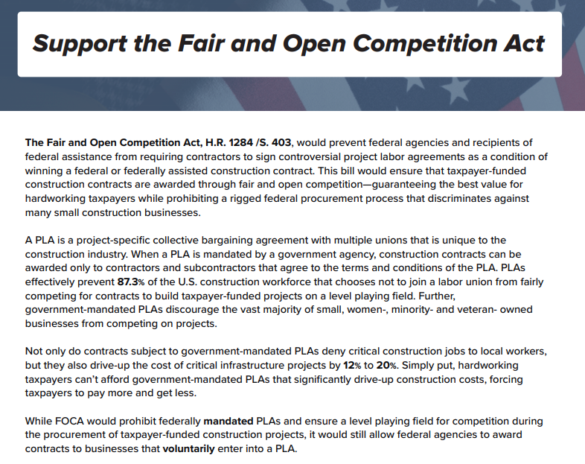
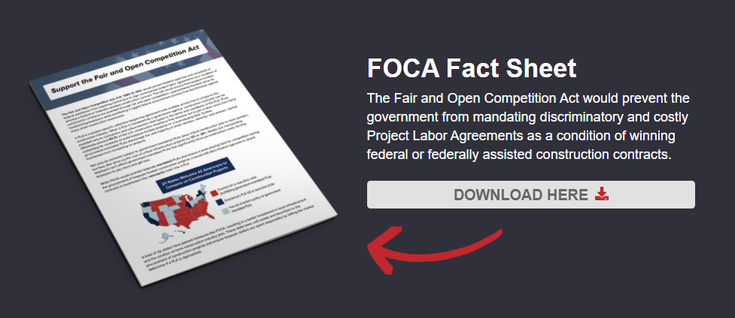
ABC/FEA SUPPORTING FOCA & FIGHTING PLAs
FreeEnterpriseAlliance.org/FOCA
Available Resources: ABC action alert, fact sheet, social media kit, paycheck stuffers, articles, email sign-ups, donate button and more.

Slide 30
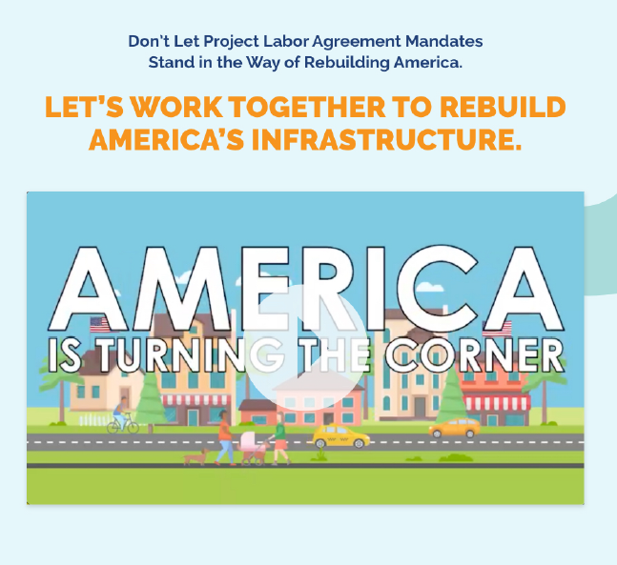
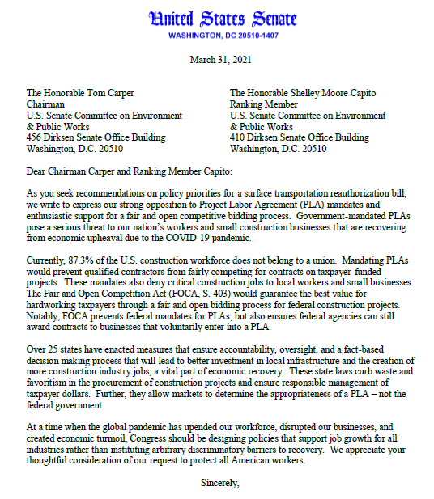
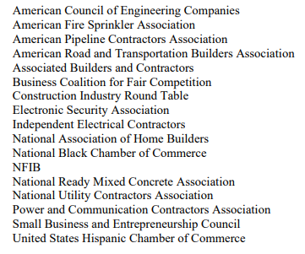
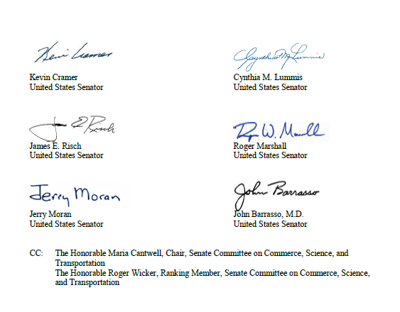
ABC & FEDERAL FOCA COALITION EFFORTS
“Build America Local” Coalition Website & Anti-PLA Campaign

Slide 31
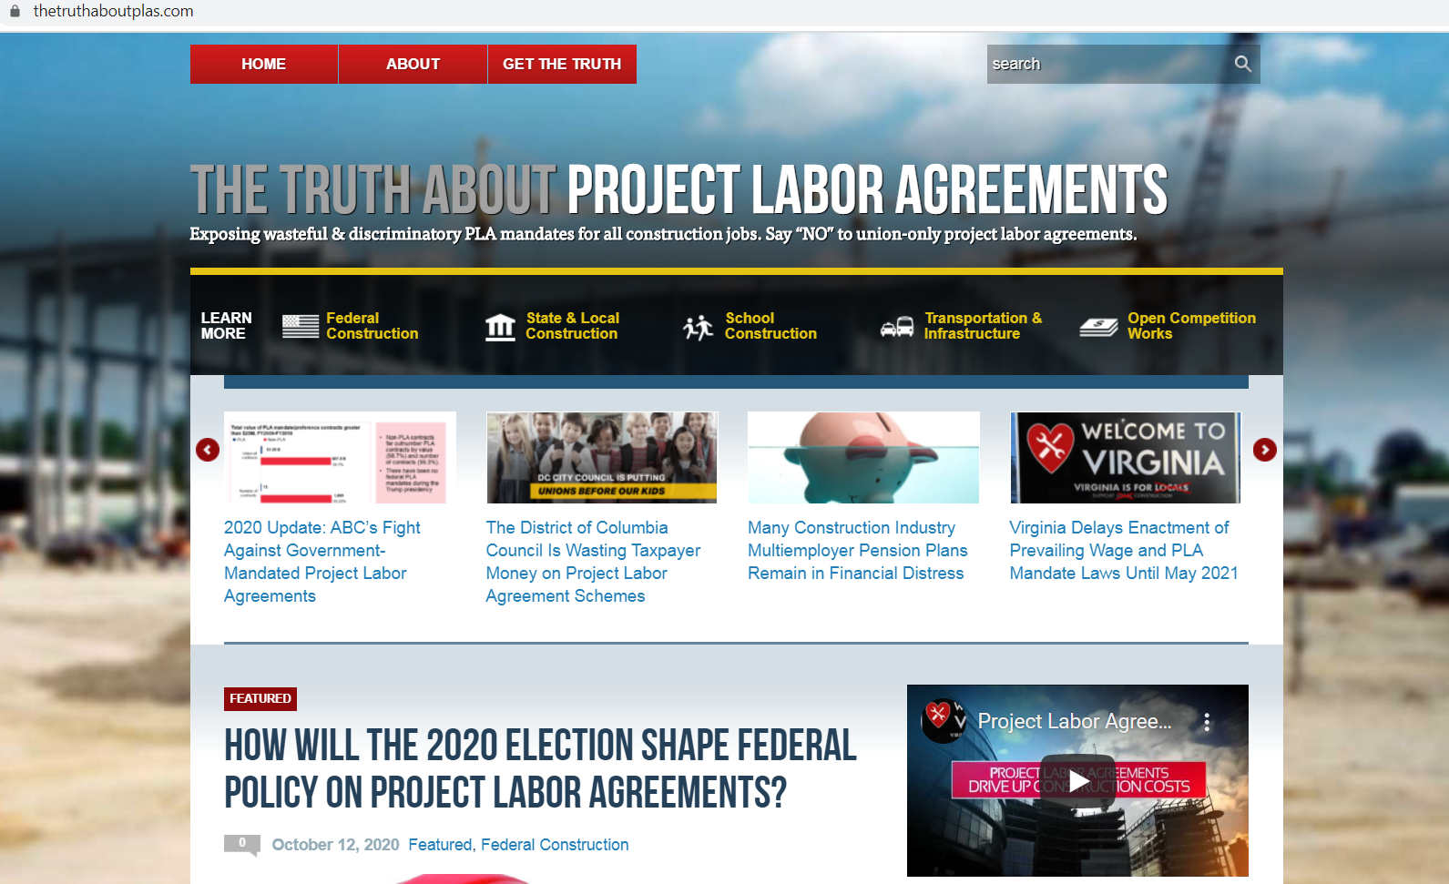
VISIT THETRUTHABOUTPLAS.COM FOR MORE INFORMATION
Facebook.com/TheTruthAboutPLAs
Twitter: @TruthAboutPLAs

Slide 32
Q&A
Brubeck@abc.org

